Slide 1
Ashland WI Regional Economic Development Plan
Wisconsin Innovation Network – Lake Superior Chapter
August 2011
Notes:
Welcome! Thanks for attending the conference. Towards the end of 2010 we made a conscientious effort to narrow our focus. Past year the WIN team spread efforts into multiple areas. We conducted a structured brainstorming session with the entire WIN team for the purposes of prioritizing our efforts. The Technology Park was selected as our number 1 priority.

Slide 2
Agenda
WIN – Lake Superior Chapter Economic Development Update
  Business Support Infrastructure
  Technology Park
Jim Maerzke – Wheelchair Technology Innovator
Jim Jermain – Northern Wis Broadband Technology Update
Questions

Slide 3

VISION
Ashland Area Technology Transfer Park
Ashland Area Economic Development
Getting Started
  Build Business Support Infrastructure
  Acquire Land Parcel
  Build First Building
  Acquire Tenants
Continued Growth
  High Skill Workforce
  Robust Regional Economy
  Regional Growth

Slide 4
Challenges – Getting Started
Madison/Milwaukee Development focused on Southern WI
Northern WI Development focus/initiative
  Regional Business Support Infrastructure
  Innovation/entrepreneurship
  New Regional Investments/Development
  Development Efforts
  Technology Infrastructure
  Financial Funding

Slide 5

Solution
Build Northern WI Business Support Infrastructure
    Develop key partnerships, currently fragmented
    Develop regional technology infrastructure
    Develop Financial Support for Land, Building, and Tenants
    Develop Regional Marketing Plan and Network
Build Technology Transfer Park, First Building
    Develop key partnerships, currently fragmented
    Land and Building Plans
    Finances = Grants + Private + Tenants
    Develop Tenant Marketing Plan

Slide 6
Business Support Infrastructure
LEVEL I – Volunteer high level guidance available locally (IP, manufacturing, marketing, lean, …)
LEVEL II – General support available locally to state-wide (IP, financial planning, project management, …)
LEVEL III – Specialized support ( Specific technologies, logistics, …)

Slide 7
Progress – Partnerships
Partnership, Fragmentation TO Team
  WIN – LS, Annual Conference
  Ashland Area Development Corporation, AADC
  Ashland City Administration
  Northland College, Wisconsin Indianhead Technical College
  University of Wisconsin-Superior
  IMPACT7
  Ashland Chamber of Commerce
  Ashland Area & Mellen School Districts

Slide 8
Progress – Business Support Infrastructure
Broadband Technology Acquisition
Regional Marketing Plans
Wisconsin ANGEL Network
PDCA, Plan – Do – Check – Adjust
  Visit Potential Customers (Tenants)
  Define Customer Needs
  Continuous Adjustments

Slide 9
Progress – Technology Transfer Park First Building
Business Plan
Benchmark Successful Business Parks
Tenant Customer Needs Identified
Feasibility Study Complete
Land and Purchase Price Identified
Preliminary Funding Initiated, IMPACT7
Attending WI Business Development Conferences, Meeting Potential Tenants

Slide 10

Next Steps
Complete Business Plan
Continue Development of Business Support Infrastructure
  Expand WIN LS partnerships
  August 5th WIN LS Conference
  Broadband Technology
Continue Technology Park First Building Efforts
  Finance Plan Development and Implementation
  Continue Planning and Implementation
  Purchase Land

Slide 11
Examples - Progress
Technology Transfer Park Tenant Recruiting Plan
Technology Transfer Park Land Acquisition Plan
Jim Maerzke - Wheelchair Technology Innovator and Business Owner
Jim Jermain – Ashland Area Broadband Technology

Slide 13
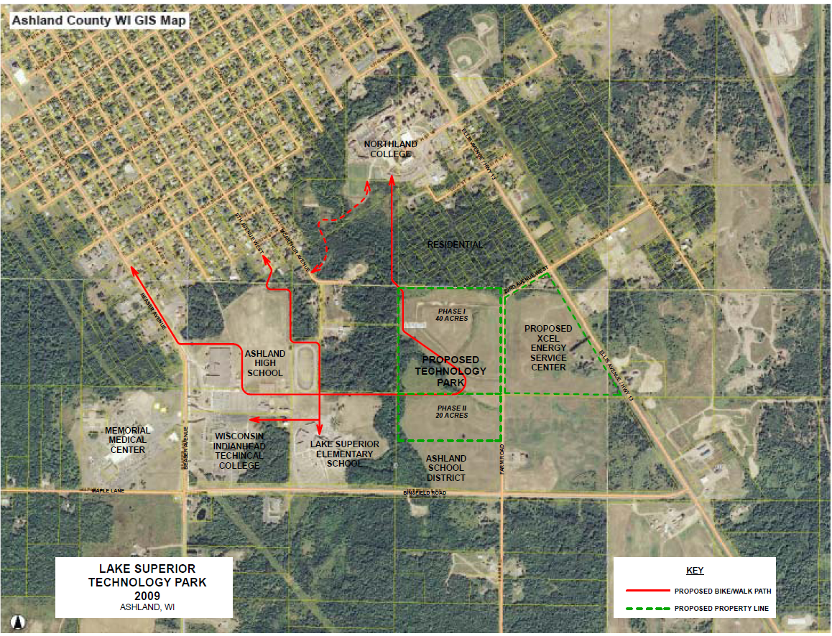
Ashland Area Land Location

Slide 14
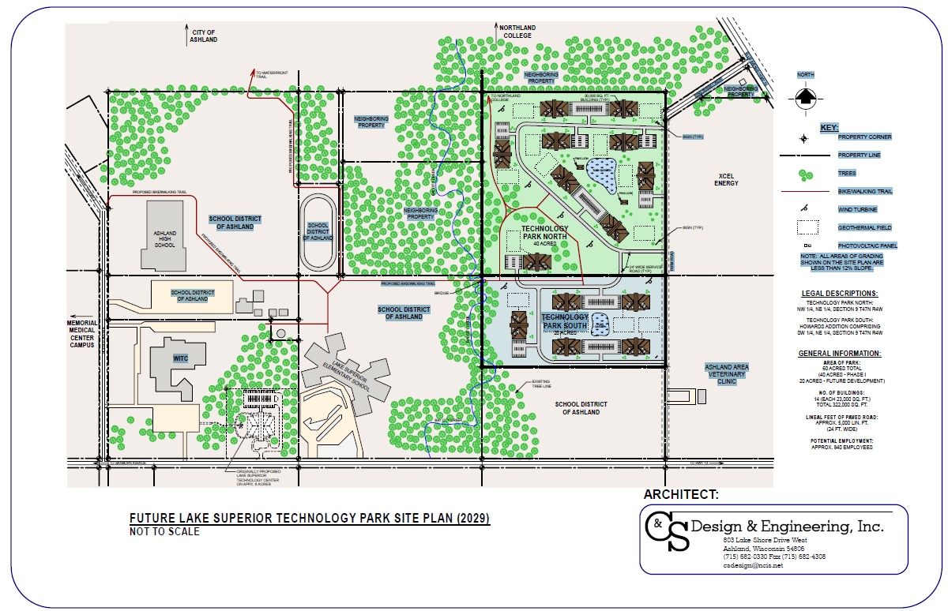
Ashland Area Land Development

Slide 15
Ashland Area Land Acquisition
Impact7 HUD Grant application submitted, includes land purchase
Price negotiated with Sellers, Right of First Refusal Contract Approved
Additional Funding Required to Complete Building, TBD

Slide 16
Guest Speakers
Jim Maerzke - Wheelchair Technology Innovator
Jim Jermain – AT&T Broadband

Slide 17

Questions

