Slide 1
Mobile Broadband Technology: The Infrastructure for Wisconsin’s Future

Slide 2
AT&T and T-Mobile Acquisition
On March 20, 2011, AT&T announced plans to acquire T-Mobile USA from German-owned Deutsche Telekom, creating a world-class technology platform in mobile broadband and wireless services in the U.S.
The Acquisition Addresses America’s Spectrum Exhaust Challenges
Driven by explosive growth for mobile broadband, the U.S. faces spectrum constraints
Spectrum is the range of airwave frequencies that enable everything from broadcast television to cell phones to mobile broadband, and even baby monitors.
The growth of airwave-dependent devices like smartphones and tablet computers has been unprecedented. According the FCC’s staff “mobile data demand will exceed available capacity by 2013.”
AT&T’s mobile data traffic grew 8000% over the past four years, and by 2015 is expected to be 8-10 times what it was in 2010.
A Fast, Efficient and Certain Solution
The combination of T-Mobile’s and AT&T’s technologically compatible networks offers a fast, efficient and certain solution to meet consumer demand for mobile broadband, improve service, and help drive growth and investment in U.S. mobile broadband networks.
"I believe that the biggest threat to the future of mobile in America is the looming spectrum crisis."
Julius Genachowski, FCC Chairman
Mobile Broadband Technology: The infrastructure for Wisconsin’s future

Slide 3
The Acquisition Will Create Significant Consumer Benefits
1. Expanded 4G LTE to over 97% of U.S. population
55 million more people will have access to AT&T’s LTE service – more than the combined populations of New York and Texas
4G means that mobile devices can be as fast or faster than wired laptops
Greater access, lower latency, and faster wireless broadband connection speeds to meet growing consumer demand for mobile broadband
2. Improved voice and data service
Increased spectrum efficiencies, combined with additional network capacity and output will deliver better voice quality, better coverage and faster data speeds
3. An additional $8 billion of private infrastructure investment
New jobs will be created when the planned network expansion gets underway
4. Investment and better mobile broadband access in rural communities
Billions invested in rural America that can improve economic competitiveness and stimulate additional investment and job creation
5. Access for 34 million T-Mobile customers to nationwide, robust 4G LTE
T-Mobile USA does not have a clear path to delivering 4G LTE
6. America’s largest wireless unionized workforce
AT&T is the only major U.S. wireless company with a union workforce, offering leading wages, benefits, training and development for employees.
“The real winner in this merger is the consumer.”
Zack Christenson
American Consumer Institute
“The parties have a surprisingly strong argument that their merger would allow better service, lower costs and more efficient use of existing spectrum without hurting consumers.”
Holman Jenkins, Jr.
Wall Street Journal
Mobile Broadband Technology: The infrastructure for Wisconsin’s future

Slide 4
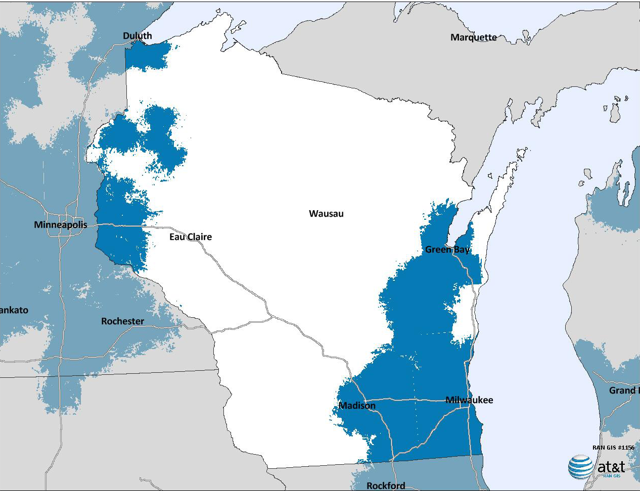
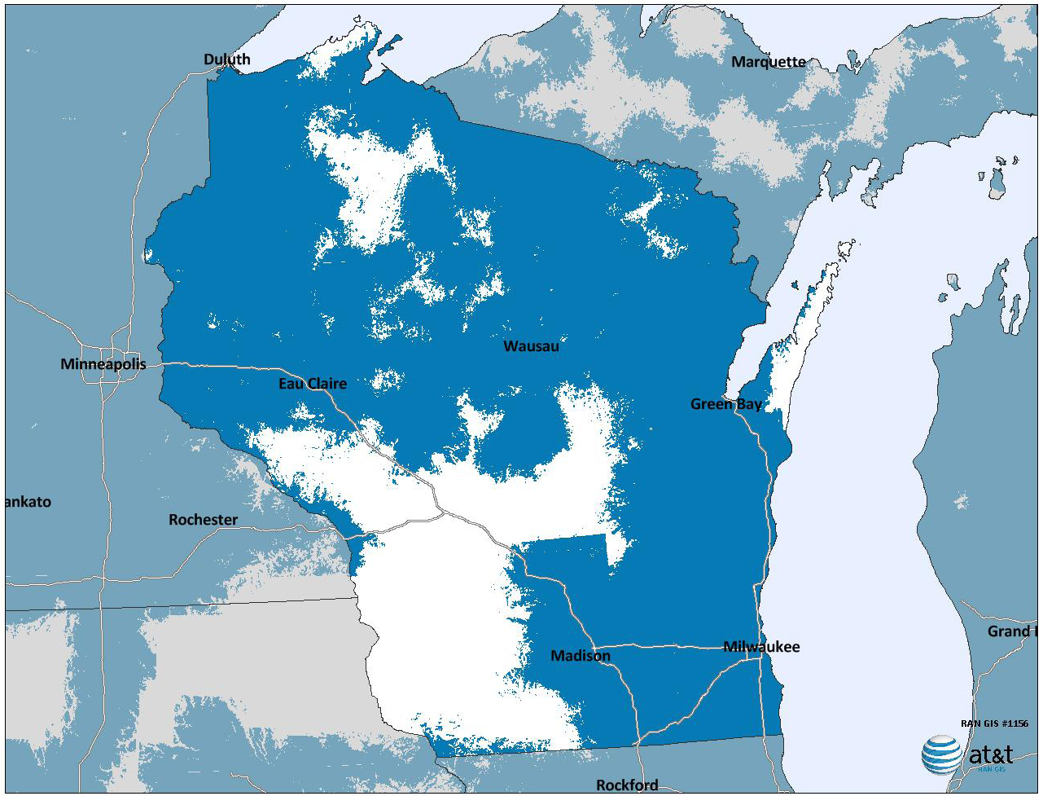
Expanded 4G LTE to Cover Over 97% of U.S. Population
Current Plan
With Merger
To present a conservative view of estimated coverage when compared to post-merger maps and to address potential deployment changes as plans are operationalized, map is based on assumptions that maximize potential coverage areas and thus depicts areas outside current pre-merger build plan. Additional information may alter estimated coverage. Actual coverage provided will vary as specific network design and construction takes place.
Maps depicts estimated coverage based on current information and modeling assumptions as of April 21, 2011. Additional information obtained post-closing may alter estimated coverage. Actual coverage provided may differ.
Mobile Broadband Technology: The infrastructure for Wisconsin’s future

Slide 5
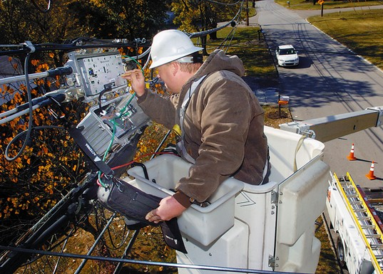
A 4G Nation: Innovation, Economic Growth & Jobs
More than $8 Billion in infrastructure spending by AT&T over seven years, enabling the economy to innovate and grow.
One job in the communications industry is associated with 2.52 indirect jobs
Phoenix Center Policy Bulletin No. 25, October 2010
Accelerated broadband deployment that creates jobs across all industries.
Every one percentage-point increase in broadband penetration is accompanied by an increase in employment of 0.2 percent to 0.3 percent per year Brookings Institution, Issues in Economic Policy, July 2007
4G LTE network in more areas can spur additional growth and hiring from small businesses that rely on broadband to compete globally and levels the playing field for innovation
For example: By 2013, over 20 billion downloads from mobile app stores are expected to drive a $30 billion industry — an industry that didn’t exist in 2008
Mobile Broadband Technology: The infrastructure for Wisconsin’s future

Slide 6
AT&T and T-Mobile Acquisition
As a result of the transaction AT&T has committed it will deploy LTE to more than 97% of the U.S. population.
For Wisconsin, we estimate this means:
More than 1.75 million additional people covered in the state
More than 90% of the state’s population covered by LTE footprint
More than 30,000 additional square miles served
More than 400% increase in geographic area of LTE footprint in the state
Mobile Broadband Technology: The infrastructure for Wisconsin’s future

Slide 7
AT&T and T-Mobile Acquisition
How You
Can Help
Mobile Broadband Technology: The infrastructure for Wisconsin’s future

Slide 8
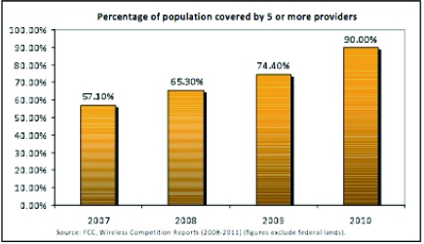
The U.S. Wireless Landscape is Fiercely Competitive
According to FCC findings, 90 percent of the U.S. population lived in census blocks covered by five or more facilities-based wireless providers in 2010
Source: FCC Wireless Competition Report (2008-2011)

Slide 9
Historically, during periods when carriers combined to achieve efficiencies, U.S. wireless prices fell
Mobile Broadband Technology: The infrastructure for Wisconsin’s future

